Slide 1


NRP 8th edition in Canada: a review of new recommendations and their rationale
Dr Emer Finan,
Dr Amuchou Soraisham,
CPS NRP Steering Committee
Notes:
Good afternoon and welcome to our presentation on the NRP 8th edition in Canada; a review of new recommendations and their rationale

Slide 2
Disclosure Statement
Faculty: Dr Emer Finan and Dr Amuchou Soraisham
Relationships with commercial interests:
  We have no affiliation (financial or otherwise) with a pharmaceutical, medical device or communications organization
Notes:
Neither myself or Dr Soraisham have any conflicts to declare

Slide 3
Objectives
Review the changes in 8th edition of NRP in Canada
Review the relevant science underlying updated recommendations
Review the administrative and educational changes related to 8th edition NRP in Canada
Notes:
The objectives of today’s talk are :
To review the clinical changes in the 8th edition of NRP in Canada
To review the relevant science underlying updated recommendations
To review the administrative and educational changes related to 8th edition NRP in Canada

Slide 4
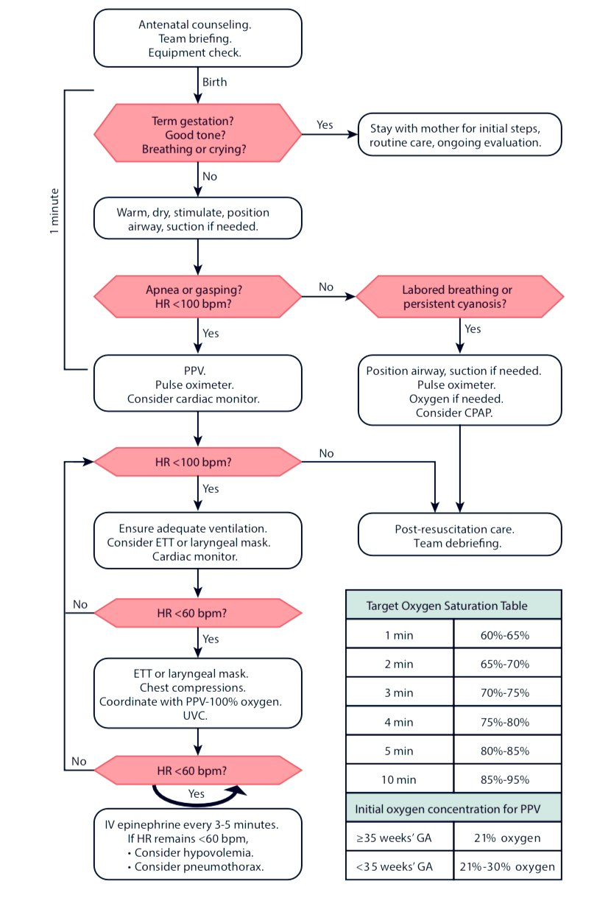
Textbook of Neonatal Resuscitation, 8th Ed. By American Academy of Pediatrics and American Heart Association. Edited by Gary M. Weiner and Jeanette Zaichkin
Notes:
This slide illustrates the new 8th edition NRP algorithm along with the target oxygen saturations and starting oxygen concentrations, both of which remain unchanged from the previous recommendations. To recap, starting FiO2 is 21% for infants greater than or equal to 35 weeks GA and for those less than 35 weeks the starting Fi02 is 21-30%. In the upcoming slides, we will go sequentially through the algorithm and highlight practice changes in the 8th edition.

Slide 5
NRP Essentials
Lessons 1 to 4 inclusive
(incl. PPV and LMA)
NRP Advanced
Lessons 1 to 11 incl
(incl. intubation and beyond)
Textbook of Neonatal Resuscitation, 8th Ed. By American Academy of Pediatrics and American Heart Association. Edited by Gary M. Weiner and Jeanette Zaichkin
Notes:
With the implementation of 8th edition NRP there will be a return to the previous practice of providing two types of course depending on needs of the learner, these being NRP Essentials and NRP Advanced. As highlighted in the adjacent part of the algorithm, NRP Essentials will cover aspects of the resuscitation up to and including corrective steps and insertion of a laryngeal mask airway. This corresponds to lessons 1 through 4 in the 8th edition NRP textbook.
NRP Advanced will incorporate further components of the algorithm including endotracheal intubation, chest compressions and medications.
The rationale for this change is not to shorten the course for providers and as such the CPS NRP Committee still recommends that courses should take at least 4 hours. Essentials and Advanced options however enable instructors to spend time focusing on skills training which is most pertinent to the needs of the provider. It is recommended however that any member of the team who may attend high risk deliveries continues to take the NRP Advanced course so they are familiar with all aspects of the resuscitation in which they may be involved.

Slide 6
Preparing for resuscitation
Team and equipment preparation: the “brief”
4 pre-birth questions
Expected gestational age
Is the AF clear ?
Any additional risk factors?
Umbilical cord management plan
Textbook of Neonatal Resuscitation, 8th Ed. By American Academy of Pediatrics and American Heart Association. Edited by Gary M. Weiner and RN MN NNP-BC Jeanette Zaichkin
Notes:
The first step in the algorithm involves preparation of the team and organization of the necessary equipment to be able to provide advanced resuscitation as required. As in the past, the role of the team “brief” is emphasized as a means not only to assign roles and accompanying tasks but also to discuss possible underlying disease processes and potential interventions required in stabilization.
In the 8th edition, the 4 pre-birth questions have changed with the removal of the question related to number of babies expected. Instead this question is replaced with a question related to the umbilical cord management plan. This reflects the importance of umbilical cord management in the care of the newborn and Dr Soraisham will highlight the updated evidence in this regard later in the talk.
The 4 pre-birth questions are now:
What is the expected gestational age ?
Is the amniotic fluid clear ?
Are there any additional risk factors ?
What is the umbilical cord management plan?

Slide 7
The “Golden minute”
Initial steps reordered
Initial respiratory assessment/HR check
Indications for PPV unchanged
Possible role of CPAP as in past
Textbook of Neonatal Resuscitation, 8th Ed. By American Academy of Pediatrics and American Heart Association. Edited by Gary M. Weiner and Jeanette Zaichkin
Notes:
As in the 7th edition the goal in the first minute is to perform an initial assessment of tone and breathing, perform initial steps and provide positive pressure ventilation as required.
The 3 initial assessment questions remain unchanged these being:
Is the infant term?
Do they have good tone?
3. Are they breathing or crying?
Of note, the order of the initial steps has changed in the 8th edition to “warm, dry, stimulate, position the airway and suction if needed”. This is to reflect common clinical practice.
As in the previous edition, it is important to note that suction should be provided only as necessary and that providers should be aware of the potential complications of vigorous deep suction such as vagal stimulation and resultant bradycardia.
Following initial steps, the provider should assess breathing and heart rate. The indications for PPV remain unchanged, namely apnoea or gasping respirations or HR < 100 bpm. If PPV is required, pulse oximeter placement is recommended as in the past. Cardiac monitor placement can also be considered at this point.
As in the past CPAP can be considered for infants who have effective spontaneous respirations but have persistent cyanosis or laboured breathing.

Slide 8
Ventilation is key !
MR.SOPA if no ↑ HR/no chest mmt after 15 secs
If HR low despite ventilation, alternate airway and 30 secs PPV
Saturation targets unchanged
Textbook of Neonatal Resuscitation, 8th Ed. By American Academy of Pediatrics and American Heart Association. Edited by Gary M. Weiner and Jeanette Zaichkin
Notes:
As in previous editions, the importance of effective ventilation is paramount.
Similar to the 7th edition, it is recommended that 15 seconds into administration of PPV, the heart rate is reassessed. If the heart rate is not increasing, chest movement should be evaluated. If the heart rate is not increasing and there is no chest movement, ventilation is ineffective and corrective steps should be taken.
As in the past this involves the MR.SOPA mnemonic. It is recommended that this is primarily done in couplets, ie Mask and Reposition the head and neck, then provide 5 further positive pressure breaths to see if any improvement; if not the next steps are to Suction the mouth and nose and Open the mouth then provide 5 further positive pressure breaths. If no improvement, the Pressure should be increased by 5-10 cm H20 and if still no improvement an Alternate airway should be placed, ie a LMA or ETT. If any of these interventions are effective in resulting in chest movement, ie adequate ventilation then PPV should be provided for 30 seconds (8th edition textbook, page 82)
If an alternate airway is required, 30 seconds of PPV should be provided through the alternate airway before reassessment of the heart rate to determine next steps .
As previously noted, oxygen saturation targets remain unchanged and Fi02 should be titrated in accordance.
The 8th edition algorithm suggests a cardiac monitor is placed at the point of alternate airway placement if not already done. This will aid in speed and accuracy of heart rate detection.

Slide 9
Circulatory support
30 seconds PPV via AA
CC if HR < 60. 3:1 ratio and 100% FiO2
If no ↑HR: “CARDIO”
If HR < 60 after 60 secs CC→ epinephrine
Textbook of Neonatal Resuscitation, 8th Ed. By American Academy of Pediatrics and American Heart Association. Edited by Gary M. Weiner and Jeanette Zaichkin
Notes:
Once an alternate airway has been sited, 30 seconds of PPV should be provided through the airway before the heart rate is reassessed. As in the past, the indication for chest compressions is a heart rate < 60 bpm after at least 30 seconds of effective ventilation. FiO2 should be increased to 100% and chest compressions should be provided at a compression to ventilation ratio of 3:1. As in the 7th edition, the two-thumb encircling technique is recommended and with an alternate airway in place and secured it is recommended that the person performing chest compressions moves to the head of the bed to faciltate access for another member of the team to insert an UVC.
The heart rate should be reassessed after 60 seconds. The mnemonic CARDIO is introduced in the 8th edition and can be used by the team to troubleshoot if the heart rate is not increasing :
“Chest movement: is the chest moving with every breath ?
Airway: Is the airway secured with an ETT or LMA?
Rate: Are 3 compressions coordinated with 1 ventilation being delivered every 2 seconds?
Depth: is the depth of compressions one-third of the AP diameter of the chest?
Inspired Oxygen: Is 100% oxygen being administered through the PPV device?” (8th edition textbook, page 169)
If the heart rate remains below 60 bpm after 60 seconds of effective ventilation and chest compressions, epinephrine is indicated along with emergency access

Slide 10
Medications
Epinephrine IV/IO dose range 0.01-0.03mg/kg
Suggested initial IV/IO =0.02mg/kg.
Suggested initial ET dose =0.1mg/kg ( no max. dose)
Flush with 3 ml normal saline
Can rpt every 3-5 mins: “consider ↑subsequent doses”
Textbook of Neonatal Resuscitation, 8th Ed. By American Academy of Pediatrics and American Heart Association. Edited by Gary M. Weiner and Jeanette Zaichkin
Notes:
As in the past the epinephrine dose range is 0.01-0.03 mg/kg via IV/IO route and 0.05-0.1mg/kg via ETT. The IV/IO routes remain preferred though the ETT route can be used while awaiting intravenous access.
The 8th edition introduces an abbreviated initial dose of 0.02mg/kg IV and 0.1 mg/kg for ETT. The ETT dose is the same as the previous abbreviated dose used for this route by the CPS however we will no longer recommend a maximum dose via the ETT, ie a 4 kg infant would now receive 0.4mg as ETT dose. This is in line with the AAP recommendations and as such there will no longer be a separate CPS medication table.
The choice of 0.02 mg/kg as the abbreviated dosage is based primarily around educational efficiency. The updated recommendation is that the IV dose is flushed with 3cc normal saline irrespective of gestational age or birthweight. Dr Soraisham will review some of the science related to these changes later in the talk.
As in past editions, epinephrine doses can be repeated every 3-5 mins however given the range in dosing and initial dose suggestions, the textbook notes that if the first dose was 0.02mg/kg IV or lower, one can consider increasing the dosage in subsequent doses

Slide 11
Additional considerations
Normal saline remains crystalloid expander of choice
Packed cells in cases of suspected fetal anemia
Consideration of other causes if not responding, eg ptx
“Reasonable time frame for considering cessation of resuscitation efforts is around 20 minutes after birth”…. “individualized based on patient and contextual factors”
Textbook of Neonatal Resuscitation, 8th Ed. By American Academy of Pediatrics and American Heart Association. Edited by Gary M. Weiner and Jeanette Zaichkin
Notes:
As in the 7th edition, normal saline remains the crystalloid volume expander of choice however as in the past, judicious use of volume expanders is recommended in particular in preterm infants at risk of intraventricular hemorrhage. Volume expanders should be reserved for situations in which there is a significant history or clinical concern for hypovolaemia. If concerns for anaemia, emergency 0- blood may be required. As always, if the infant is not responding to resuscitation efforts, it is important to consider other etiologies such a pneumothorax which would require thoracocentesis.
The 8th edition notes that 20 minutes may be a reasonable timeframe in which to consider discontinuation of resuscitative efforts if no response but notes that this is “individualized based on patient and contextual factors”. Dr Soraisham will also refer to some of literature related to this topic in his upcoming slides.

Slide 12
Objective -2
Review the relevant science underlying updated recommendations
Notes:
And with that I will now hand over to Dr Soraisham who will review the relevant science underlying some of the changes we have just discussed .
Thank you Emer. I will review the relevant science underlying updated recommendations.
Resuscitation science is based on the ILCOR review (International Liaison Committee on Resuscitation- it is consortium of experts from 7 resuscitation councils around the world, The Neonatal task force of ILCOR evaluates current state of resuscitation science and publishes the consensus statement and recommendation. Now it is published continuously instead of every 5 years in the past.

Slide 13
Timing of umbilical cord clamping
DCC for 30-60 s is reasonable for both term and preterm infants who do not require resuscitation at birth.
Notes:
Delayed cord clamping (DCC) for at least 30 to 60 sec is recommended for term and preterm infants who do not require resuscitation at birth. This is based on the findings that DCC improves hemodynamic stability and preterm infants who receive DCC are less likely to receive inotropes and blood transfusion while term infants are more likely to have improved hematological parameters ( increased Hb and ferritin at 3-6 months).

Slide 14

Timing of CC for non-vigorous babies
Research on resuscitation with intact cord ongoing
If PPV required, cord should be cut and infant transferred to overbed warmer for resuscitation
Notes:
Currently the optimal timing of cord clamping for non-vigorous infants who require immediate resuscitation is not known. Research is ongoing on resuscitation with intact placental circulation.
Within the clinical setting however, while some initial suction or stimulation with the cord intact may be reasonable if the infant requires further intervention such as PPV it is currently recommended that the cord is cut and the infant is brought to the overbed warmer for resuscitation.
Early cord clamping should be considered for cases when placental transfusion is unlikely to occur, such as maternal hemorrhage or hemodynamic instability, placental abruption, or placenta previa.

Slide 15
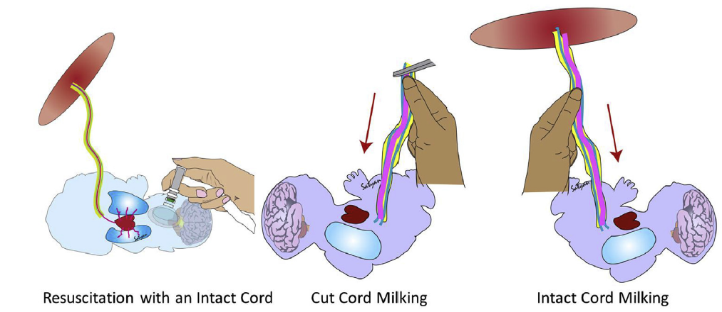
Umbilical Cord Milking (UCM)
Notes:
Cord milking (CM) has been used as an alternative to DCC
Cord milking can be done either after the cord is cut or when the cord is still intact (before cord clamp is applied)

Slide 16
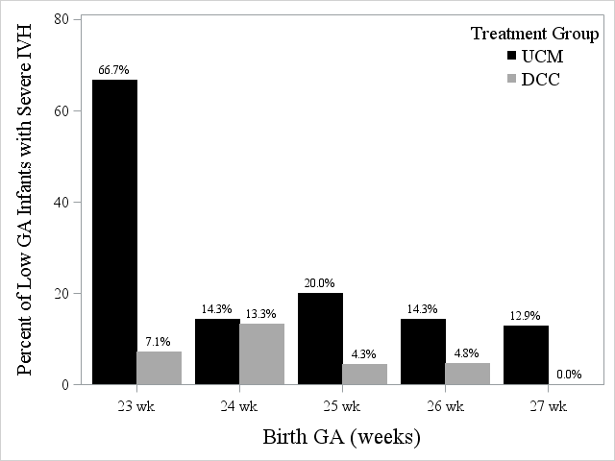
Cord Milking versus DCC
Risk of severe IVH:
UCM (22%) vs DCC (6%);
[ 26%, NNH=6]
Cord milking is not recommended for infants <28 weeks
Number of Infants with Severe IVH by GA
Katheria et al. JAMA 2019;322(19):1877-1886
Notes:
In a multicentre trial, Katheria et all compared DCC versus CM. There was a significant increase in incidence of severe IVH among CM compared to DCC groups among infants <28 weeks ( 22% versus 6%). Hence umbilical cord milking is not recommended for infants <28 weeks.

Slide 17
Hemodynamic Changes During Cord Milking
Lack of cerebral autoregulation and right to left ductal shunt result in fluctuations in flow to an immature brain with fragile germinal matrix.
IVH
Increased venous return to the right atrium enters PFO and aorta
Pulmonary vasoconstriction
Umbilical cord milking
Notes:
Cord milking leads to sudden increase in venous return to the right atrium, then through the patent foramen ovale to the left side of the heart and to the aorta. Lack of cerebral autoregulation and right to left ductal shunt results in sudden fluctuation in blood flow to the immature and fragile germinal matrix of the brain, resulting in Intraventricular hemorrhage. Hence umbilical cord milking is not recommended in the 8th edition.

Slide 18
Sustained Lung Inflation(SLI)
Providing longer SLI before initiating PPV can inflate the lungs and increase FRC.
Meta-analysis showed SLI- ↑ mortality in preterm infants < 29 wk and SI is not recommended
There is insufficient evidence for or against the use of SLI for term and late preterm infants.
Wyckoff M et al. Circulation, 2020;142(Supp): S185-S221
Kapadia VS, et al. Pediatrics. 2021;147:e2020021204.
Notes:
Though Sustained Lung Inflations (SLI) are not used in the NRP algorithm, they are incorporated into certain resuscitation council guidelines around the world.
Multiple clinical trials of SLI have been published after the 2015 recommendations ( including the SAIL trial) prompting this recent systemic review.
This meta-analysis of 10 trials which included 1502 newborns who received PPV for bradycardia or ineffective respirations at birth showed no benefit or harm from initiating PPV with sustained inflation > 1 second compared with initiating PPV with intermittent inflations lasting 1 second or less.
However, there was an association between SLI and increased mortality in infants <29 wks and therefore SLI is not recommended

Slide 19
Epinephrine dosing
Dose
    IV or IO = 0.02 mg/kg (equal to 0.2 mL/kg)
      May repeat every 3 to 5 minutes
      Range = 0.01 to 0.03 mg/kg (equal to 0.1 to 0.3 mL/kg)
    Endotracheal = 0.1 mg/kg ( equal to 1 mL/kg)
      Range = 0.05 to 0.1 mg/kg (0.5 to 1 mL/kg)
Flush: Follow IV or IO dose with a 3-mL saline flush (previous 0.5-1ml)
Notes:
The suggested 8th edition epinephrine dosage is 0.02 mg/kg (to enhance the educational efficiency). The current dose ranges are extrapolated from the adult data.
The 7th edition NRP recommended flush volume of 0.5-1 cc only clears epinephrine past the 5 Fr UVC which has an internal volume of 0.55 cc and as such may deposit the medication in the umbilical vein /liver.
In the absence of umbilical blood flow (as in cardiac arrest), the inlet of the ductus venosus (DV) offers higher resistance to flow. The terminal portion of the inferior vena cava and DV do not have valves and pressure from chest compressions can potentially cause backflow.
Epinephrine increases portal venous resistance promoting distribution within the liver.
Epinephrine delivery to the right atrium can potentially be enhanced by a quick flush with a mini-bolus to maintain patency of the DV and enhance delivery to the heart in the absence of spontaneous circulation.

Slide 20
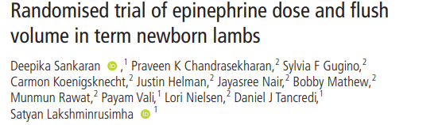
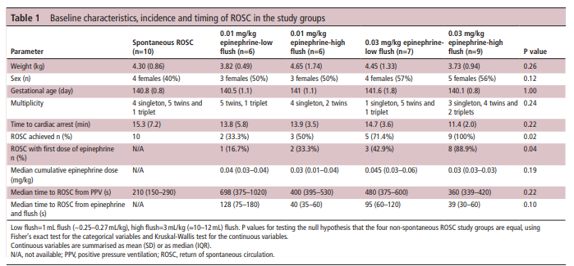
Sankaran D, et al. Arch Dis Child Fetal Neonatal Ed 2021;0:F1–F6.
Notes:
-In this study, the term newborn lambs with cardiac arrest were randomised to 4 groups- (a) Low dose epinephrine ( 0.01mg/kg) followed by low flush volume (1ml) (b) Low dose epinephrine (0.01mg/kg) followed by high flush volume (3 ml/kg), (c) High dose epinephrine (0.03 mg/kg) followed by low flush volume (1 ml) and (d) High dose epinephrine (0.03 mg/kg) followed by high flush volume(3ml/kg).
-Highest (100%) return of spontaneous circulation (ROSC) was achieved with high dose epinephrine with higher flush volume.
ROSC was five times faster with 0.03 mg/kg epinephrine compared with 0.01 mg/kg and three times faster with 3 mL/kg flush compared with 1 mL flush.

Slide 21
Epinephrine
Epi (0.03mg/kg) - earlier and ↑ ROSC compared with the 0.01mg/kg dose.
Epi (0.03mg/kg) followed by a 3mL/kg flush - ↑ the incidence of ROSC (100%) and quicker ROSC without higher HR or BP compared with 0.01mg/kg dose.
Sankaran D, et al. Arch Dis Child Fetal Neonatal Ed 2021;0:F1–F6.
Notes:
Epinephrine 0.03 mg/kg is associated with earlier and higher incidence of ROSC compared with the 0.01 mg/kg dose.
2 Administration of 0.03 mg/kg of epinephrine followed by a 3 mL/kg flush increases the incidence (100%) and quicker ROSC without higher HR or BP compared with 0.01 mg/kg dose.

Slide 22
Timing of discontinuation of resuscitation
Difficult to decide how long to continue resuscitation at birth
In recent years, long-term outcomes for survivors requiring prolonged resuscitation have improved somewhat.
Notes:
It is very difficult to decide how long to continue CPR at birth. Previously it was suggested to stop after 10 minutes of CPR with asystole.
In recent years, long.-term outcomes for survivors requiring prolonged resuscitation have improved somewhat.
The ILCOR Neonatal Task Force recently reviewed this question

Slide 23
Outcome of infants experiencing resuscitation beyond 10 minutes
Systemic review of 15 studies , N=470
Survival to discharge, 13 studies
176 /432 (41%)
Survival to last follow up, 15 studies
187/470 (40%)
Survival without NDI, 13 studies , n=277 infant
18%- survived with NDI
11% - survived without NDI
69% died by follow-up, 2% lost to follow up
Wyckoff M et al. Circulation, 2020;142(Supp): S185-S221
Notes:
Systemic review was conducted by ILCOR-NLS task force. A total of 15 studies were included with a total of 470 infants (no of infant in study- range from 3 -177 infants)
41% survived to discharge from hospital.
40% were alive at the time of follow up ( follow up: 4 months -8 years)
Among those who survived, 80 were followed and 11% survive without moderate-severe neurodevelopmental impairment(NDI); 18% had NDI.
Failure to achieve ROSC in newborn despite 10 to 20 m of intensive resuscitation is associated with a high risk of mortality
and a high risk of moderate-to-severe neurodevelopmental impairment among survivors.
In recent years, long-term outcomes for survivors requiring prolonged resuscitation have improved somewhat.
Follow up range from 4 month-8 years in above studies ( no of infant range from 3 -177 infants)
80 suvivors were assessed for the NDI

Slide 24
Outcomes of newborn infants who received ≥ 20 min of CPR after birth
Only 39 infants in whom first detectable HR or HR >100/min occurred at or beyond 20 minutes after birth.
15/39 (38%) survived until last follow-up
6/15 (40%) of survivors did not have NDI
Wyckoff M et al. Circulation, 2020;142(Supp): S185-S221
Notes:
There is extremely limited data on the outcomes of newborn infants who received 20 or more minutes of CPR after birth.
This systemic review included 5 studies with only 39 infants in whom the first detectable HR or HR >100/min occurred at or beyond 20 min
Of these, 38% (15/39) survived until last follow-up and 40% (6/15) of survivors did not have moderate or severe NDI

Slide 25
Timing for discontinuation
Reasonable time frame for considering cessation of resuscitation effort is around 20 minutes after birth
It should be individualized based on patient and contextual factor:
  Optimal resuscitation
  Availability of advanced NICU care
  Specific circumstances before delivery
  Wishes expressed by the family

Slide 26
Objectives 3
Review the administrative and educational changes related to 8th edition NRP
Notes:
Finally we would like to review the administrative and educational changes related to the implementation of 8th edition NRP in Canada.

Slide 27
Administrative/Educational Changes
Focus on team factors and QI considerations in each chapter
Additional chapters on ergonomics and human performance, resuscitation outside delivery room, integration of QI initiatives
Notes:
The 8th edition NRP textbook includes a focus in each chapter on team factors and Quality Improvement considerations.
In addition, additional chapters focus on ergonomics and human performance in neonatal resuscitation, resuscitation outside of the delivery room and the integration of QI initiatives in neonatal resuscitation.

Slide 28
Course Format in Canada
Essentials and Advanced options
Online exam, skills practice, Integrated Skills Assessment, simulation & debriefing
Essentials online learning: chapters 1-4
Advanced online exam: chapters 5-11
Course completion every 2 years
Notes:
As noted, the 8th edition of NRP will have both Essentials and Advanced options for provider courses. As previously noted, the minimum recommended duration of provider course is still 4 hours however the Essentials and Advanced options allow instructors to tailor the delivery of practical skills training to the needs of their learners. While it would be an institutional decision which provider course is required based on clinical practice, the CPS NRP committee recommends that any team member who may attend deliveries and care for newborns with risks factors for resuscitation complete the advanced course.
The CPS will retain the same instructor-led format for both essentials and advanced provider courses and this process will comprise prereading the textbook, attending for in-person skills practice and integrated skills practice and assessment following by a team-based simulation and debriefing exercise.
Those participants taking the NRP Essentials course will complete the essentials online exam prior to the instructor-led course while those taking the NRP Advanced course will complete the Essentials online exam along with the Advanced exam which will cover chapters 5-11
As in the past course completion is required every two years. As has always been the case, NRP course completion is not a certification and does not imply competence.

Slide 29
Online Learning Assessment
Interactive online assessment
Learner asks to self-assess
Feedback and time to complete contingent on performance and alignment with self-assessment
Notes:
The NRP Essentials online learning assessment is tailored to meet the needs of the individual learner. In completing their assessment, participants are asked to self-assess and feedback is provided depending on performance and alignment with self-assessment. Time taken to complete the assessment is dependent on these factors.

Slide 30
Implementation in Canada
7th edition exam not available after Dec 31, 2021. Launch of 8th edition January 1, 2022
Instructors will be required to the 8th edition exam prior to teaching courses
Resources:
-Updated FAQ
-Revision of ISSA
-Speaker-noted slides and recording from this presentation
-CPS Pedagogy site: instructor resources including sim and
debriefing videos, instructor course resources
Notes:
As the 7th edition will no longer be available after December 31, 2021, the launch date for the 8th edition in Canada will be January 1, 2022. NRP instructors will be required to take the 8th edition online exam prior to teaching 8th edition provider courses.
This edition does not contain a significant number of educational clinical changes however the CPS NRP Education Subcommittee are currently working on a number of 8th edition resources including updated FAQs and revision of the Integrated Skills Station Assessment to reflect the 8th edition changes.
This presentation will also be made available with speaker notes for use by Instructors and Instructor-Trainers.
The CPS Pedagogy site includes a number of instructor resources which are regularly updated. As there is no longer an instructor manual, this site holds many important instructor tools including simulation and debriefing instructional videos and instructor course guides and resources. We always welcome suggestions for additional resources which are helpful to the NRP community so please contact us with any suggestions.

Slide 31
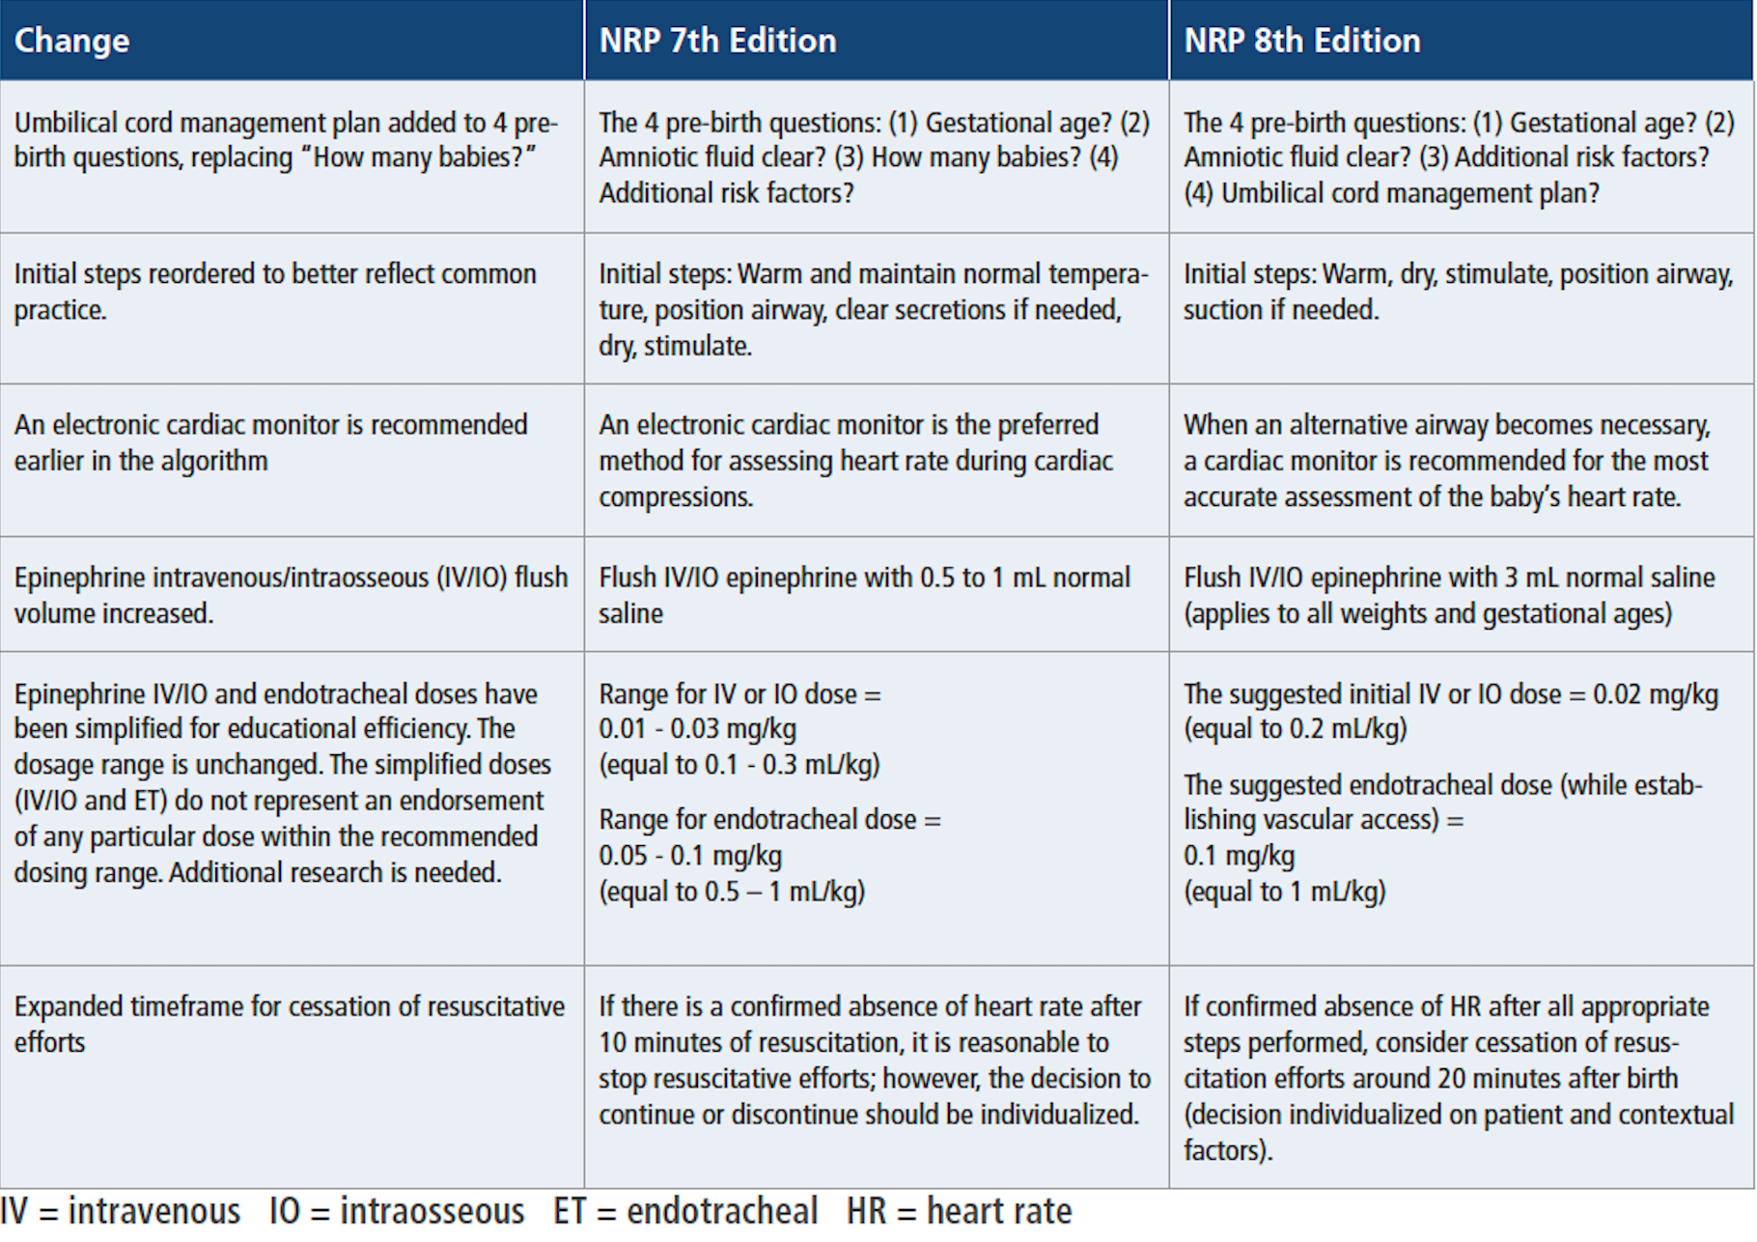
https://downloads.aap.org/AAP/PDF/NRP%208th%20Edition%20Busy%20People%20Update%20(1).pdf
Notes:
To summarize , the main changes in 8th edition NRP are outlined on this slide
Umbilical cord management replaces the question in regard to the number of babies in the 4 pre-birth questions
The initial steps of resuscitation have been reordered to reflect common clinical practice
The use of the cardiac monitor is suggested earlier in the algorithm
An abbreviated IV dose of epinephrine 0.02mg/kg is suggested as the initial dose. The ETT abbreviated dose remains unchanged and is 0.1mg/kg however there will no longer be a maximum recommended ETT dose, ie a 4 kg infant would receive 0.4 mg via the ETT . The recommended IV flush after epinephrine administration is 3 cc irrespective of gestational age or birthweight
In regard to discontinuation of resuscitation efforts the NRP textbook states that 20 minutes after birth is a “reasonable time frame for reconsidering cessation of resuscitation efforts” but notes the decision should be “individualized based on patient and contextual factors”

Slide 32
Questions

